Slide 1
Pure Substances vs. Mixtures

Slide 2
Pure Substances
Type of matter with a fixed composition (has a chemical formula)
Can be an element or compound
Ex: water, helium, salt, aluminum

Slide 3
Pure Substances: Elements
All atoms in a substance have the same identity
Ex: pencil point = carbon atoms
penny = copper atoms
thermometer = mercury atoms
oxygen tank = oxygen atoms

Slide 4
Pure Substances: Compounds
Two or more elements combined in fixed proportions to form substances
Ex: H₂O = water
CaCO₃ = chalk
NaCl = salt

Slide 5
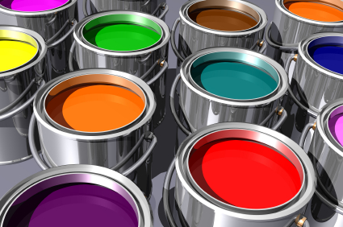
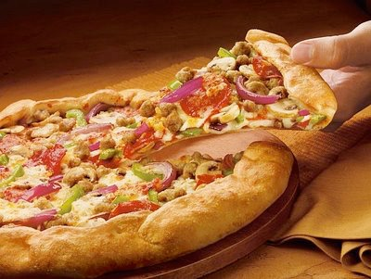
Mixtures
Material made of 2 or more substances that can be separated by physical means
Two types: heterogeneous and homogeneous mixtures

Slide 6
Heterogeneous vs. Homogeneous Mixtures
Heterogeneous
Mixture in which different materials can be distinguished easily
Ex: soups, salad dressings, concrete, cherry vanilla ice cream, pizza
Homogeneous
Contains 2 or more gaseous, liquid, or solid substances blended evenly together
Ex: flat pop, sugar water, paint

Slide 7
Solutions
Another name for homogeneous mixture
Made of very small particles, remains uniformly mixed
Solution is made of a solute (substance being dissolved) and solvent (substance doing the dissolving)
Ex: saltwater, Kool-Aid, pop, gasoline

