Slide 1
Observational Investigations

Slide 2
What do you think makes an observation GOOD?

Slide 3
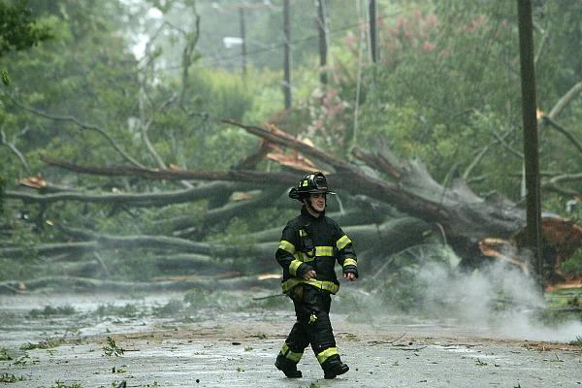
What might have caused the tree damage?

Slide 4
Observations
Observation: using what you see, feel, taste, hear, or smell to gather information about the world around you
Scientists use observations to describe what they experience
Scientists make & record observations with care
Scientists often use tools to extend or enhance their observations
Scientists test their ideas against observations
YET… observations are not enough!

Slide 5
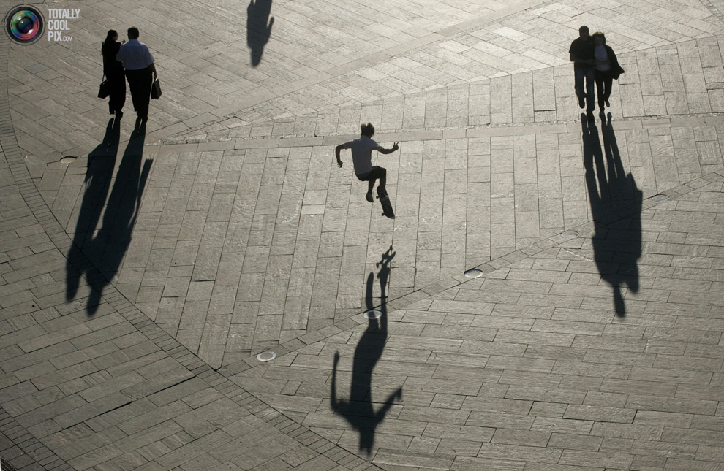
What characteristics of shadows do you notice?

Slide 6
In what direction do you think the sun is? How high might it be in the sky?

