Slide 1
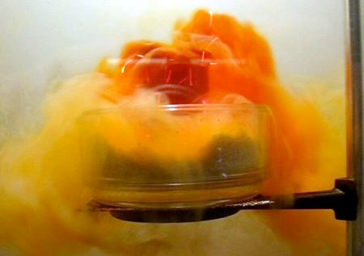
Nonmetals and Metalloids
Bromine and its vapor!

Slide 2
I. Nonmetals
A. Nonmetals found on right hand side of periodic table
B. Characteristics
1. Most are gases at room temp.
2. Dull
3. Brittle and powdery
4. Not malleable or ductile
5. Electrons held tightly by nucleus

Slide 3
I. Nonmetals
6. Poor conductors of heat and electricity
7. Form ionic and covalent bonds
8. Many form negative ions (happens when nonmetals gain electrons from metals)
9. Do not have luster (not shiny)
10. Many electrons in highest energy level
11. Tend to accept electrons from other elements

Slide 4
II. Metalloids
A. Found on the zig zag line, between metals and nonmetals
B. Characteristics
1. Properties of metals and nonmetals
2. Conduct heat and electricity but not as well as metals
3. Shiny solids but less luster than metals
4. Some are semiconductors

Slide 5
II. Metalloids
C. 3 examples of elements that are metalloids
B, Si, Ge, As, Sb, Te

Slide 6
III. Halogens
A. Found in Group # 17
B. Characteristics
1. 7 electrons in outer energy level
2. If a halogen gains an electron from a metal an ionic compound is formed (salt)
3. In most of the foods you eat

Slide 7
III. Halogens
C. Uses:
a. Chlorine in pools
b. Bromine dyes in cosmetics (lipstick)
c. Household cleaning agents, bleaches

Slide 8
IV. Noble Gases
A. Found in Group # 18
B. Characteristics
1. Outer energy level is full with 8 electrons
2. Colorless gases
3. Don’t really combine with other elements
4. All exist in Earth’s atmosphere

