Slide 1
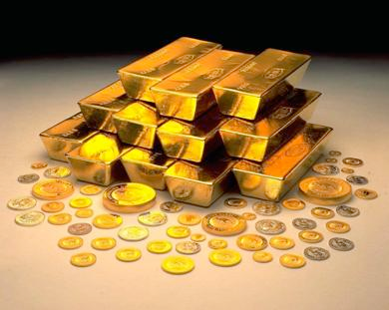
Metals Outline

Slide 2
I. General Characteristics
A. Most metals are silver or gray
B. Most metals have high melting points (except gold and silver)
C. Hard, shiny solids at room temp.
D. Good conductors of heat and electricity
E. Reflect light (luster)

Slide 3
General Characteristics
F. Malleable (hammered or rolled into sheets)
G. Ductile (drawn into wires)
H. 1-3 electrons in their outer energy levels
I. Gives up electrons easily

Slide 4
General Characteristics
AND……………………..Write this down!!……….
MOST ARE SOLID AT ROOM TEMP.
ABOUT 80% OF KNOWN ELEMENTS ARE METALS

Slide 5
II. Alkali Metals
A. Found in Group 1
B. General characteristics
1. Soft, low densities, melt at low temps.
2. Highly reactive - combine easily with other elements
3. 1 electron in its outer energy level
4. Found in nature only in the form of compounds ex: Nacl

Slide 6
II. Alkali Metals
5. Some uses:
a. Need potassium and sodium to stay healthy
b. Use lithium compounds to treat bipolar disorder

Slide 7
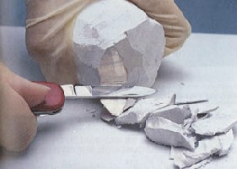
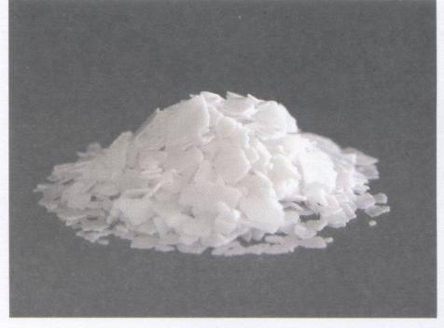
Sodium
Potassium

Slide 8
III. Alkaline Earth Metals
A. Found in Group 2
B. General Characteristics
1. So reactive that they are not found freely in nature
2. 2 electrons in outer energy level
3. Shiny, malleable, ductile

Slide 9
III. Alkaline Earth Metals
4. Uses for Magnesium:
a. Used in fireworks to produce bright white color
baseball and softball bats
5. Uses for Calcium:
a. Calcium carbonate is in your bones to make them strong
b. Marble and limestone

Slide 10
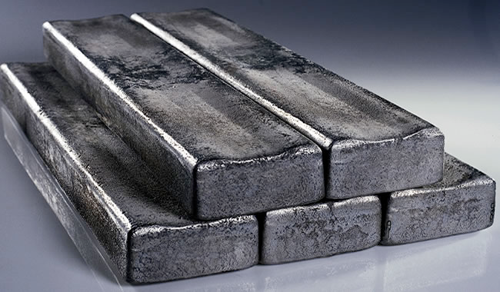
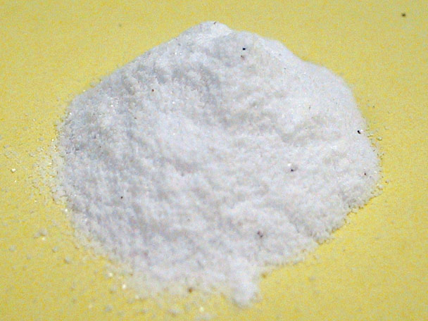
Magnesium
Calcium Carbonate

Slide 11
IV. Transition Metals
A. Found in Groups 3 to 12
B. General characteristics
1. 1 or 2 electrons in outer energy level
2. Less active than those in groups 1 & 2
3. Shiny
4. High melting points
5. Good conductors of heat and electricity
6. Found in ores (minerals w/ metal compounds)

Slide 12
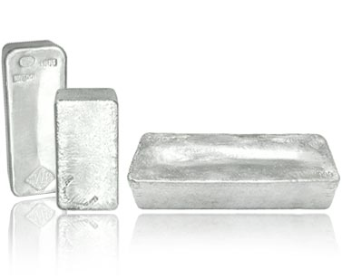
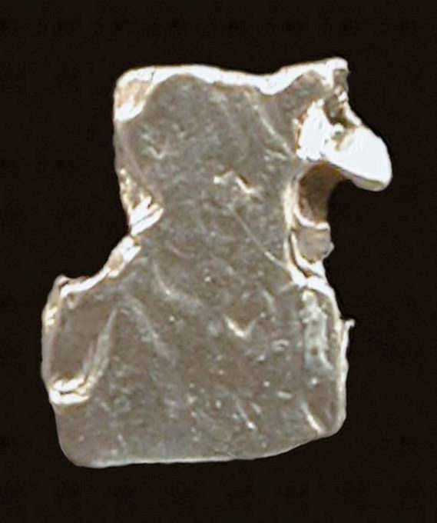
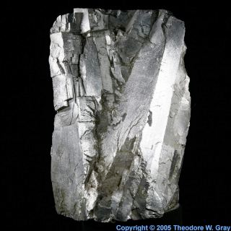
Silver
Copper
Platinum
Iron

Slide 13
V. Inner Transition Metals
A. Found in 2 separate rows on the bottom
B. Characteristics of Lathanides (1st row)
1. Elements with atomic #’s 58-71
2. Used for?? Colors on your T.V., film industry

Slide 14
V. Inner Transition Metals
C. Characteristics of Actinides (2nd row)
1. Elements with atomic #’s of 90-103
2. All actinides are radioactive and unstable.
3. Two uses?? Weapons, camera lenses

