Slide 1
What does my graph need?
Data on the graph
X-axis labeled correctly
Y-axis labeled correctly
Title
Line of best fit
Conclusion statement

Slide 2
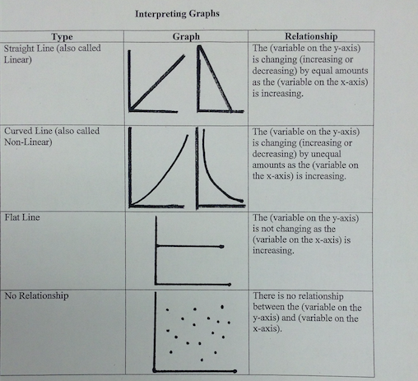
Conclusion Statement

Slide 3
Data
Position (m) | Time (s)
2 | 4
5 | 12
8 | 15
9 | 21
13 | 26
15 | 38
20 | 53
Speed (m/s) | Time (s)
3 | 6
6 | 8
12 | 16
15 | 22
18 | 29
22 | 36
25 | 49

Slide 4
